Slide 1
Software Project Management
Ch # 6: Software Requirements

Slide 2
Software Requirements Specification
A software requirements specification (SRS) is a complete description of the behavior of the software to be developed. It includes a set of use cases that describe all of the interactions that the users will have with the software
The SRS is the most important work product that is produced by the requirements engineering project activities. All later work products—software design and architecture, code, test plans—are based on the SRS

Slide 3
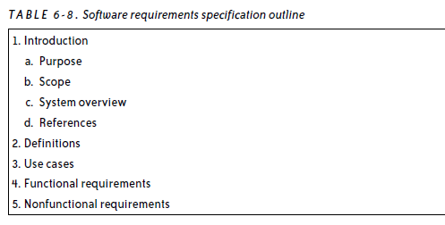

Slide 4
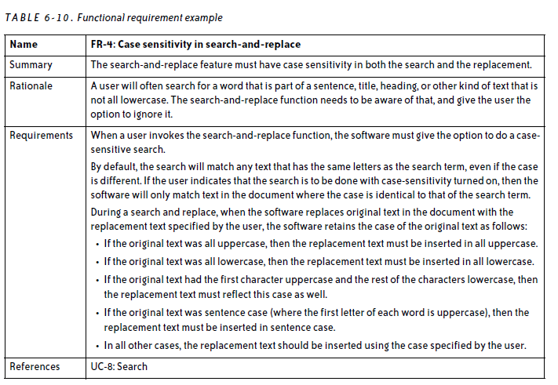

Slide 5
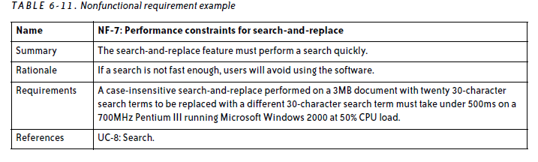

Slide 6
Develop the SRS Iteratively
The goal of the SRS development script is to remove as many defects as possible from the SRS.
Many people have trouble figuring out what constitutes a defect. In this case, a defect is any planned software behavior a project team member, user, stakeholder, or decision-maker does not agree with
The best way to prevent defects is through iteration.

Slide 7
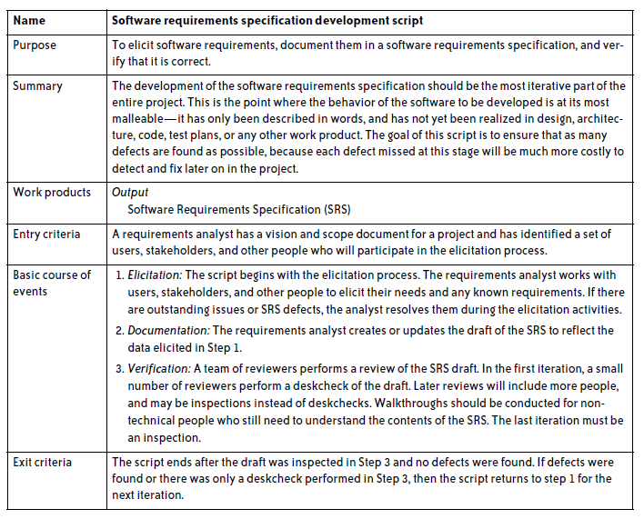

Slide 8
Requirements Differ from Design
It is hard for them to describe the behavior of a piece of software without talking about windows, forms, buttons, checkboxes, clicking, dragging, etc.
The difference between scope, requirements, and design is a very important distinction that the entire project team should be familiar with.

Slide 9
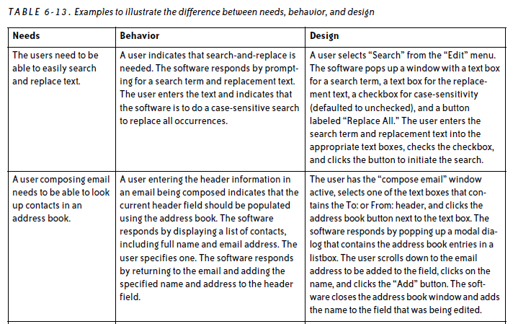

Slide 10
Change Control
Change control is a method for implementing only those changes that are worth pursuing, and for preventing unnecessary or overly costly changes from derailing the project.
Change control is essentially an agreement between the project team and the managers that are responsible for decision-making on the project to evaluate the impact of a change before implementing it.

Slide 11
Establish a Change Control Board
The most important part of change control is a change control board (CCB). There are certain people in the organization who have the power to change the scope of the project.
Before the project begins, the list of CCB members should be written down and agreed upon, and each CCB member should understand why the change control process is needed and what her role will be in it.

Slide 12
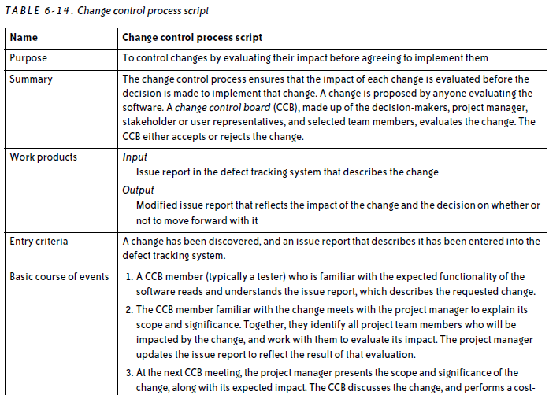

Slide 13
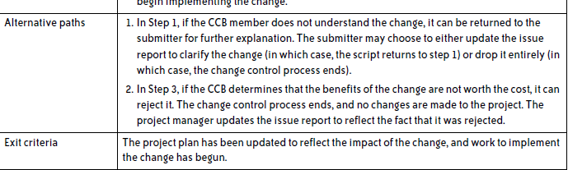

Slide 14
Evaluate Changes in the CCB Meeting
During the CCB meeting, the project manager explains the change to the rest of the CCB.
Once the CCB is brought up to speed, it must determine what project work products will have to be changed
The CCB must evaluate every change that is requested.
It is important that when the CCB is being organized, the project manager makes sure that each member understands that this sort of time commitment may be necessary
Analyze the Impact of Each Change

